Slide 1
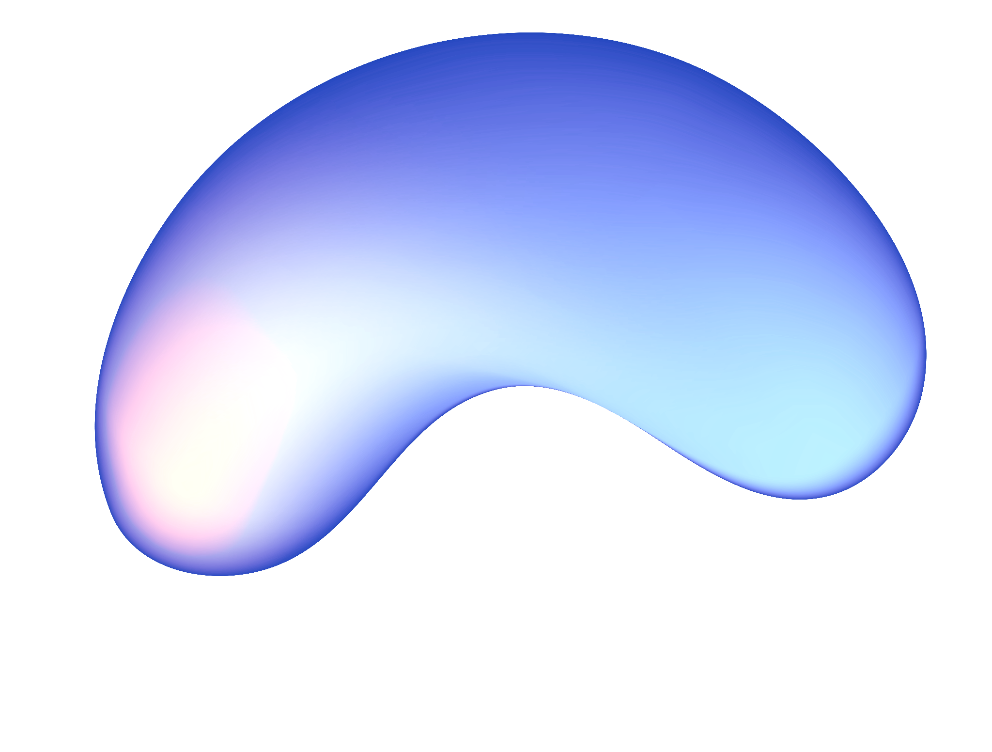
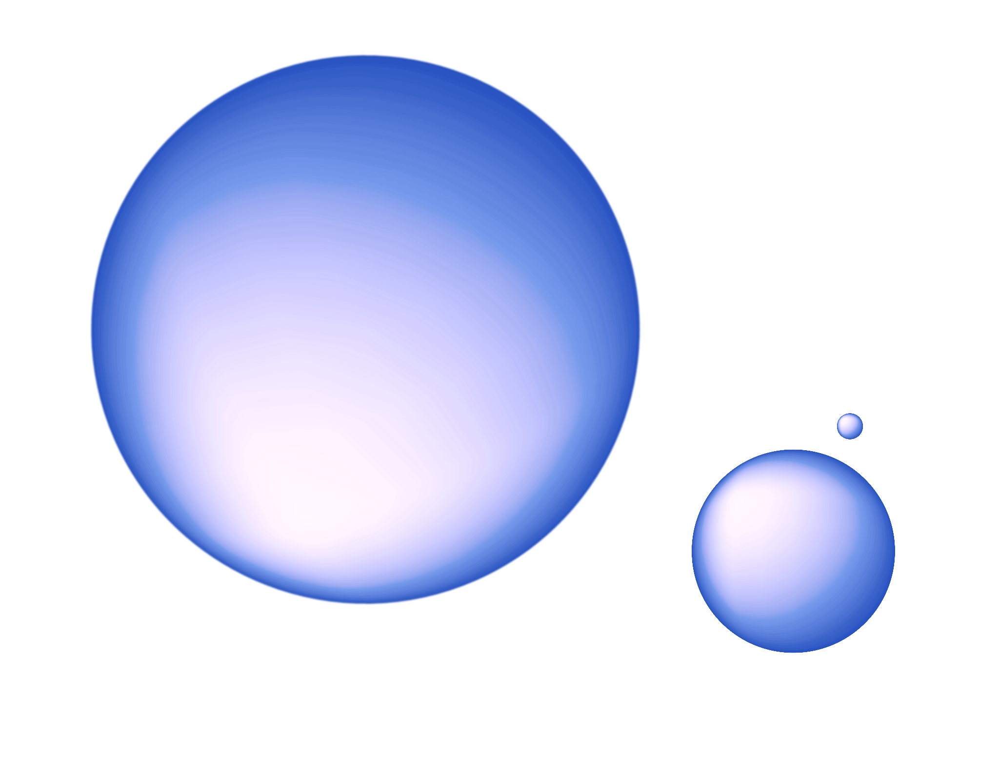
AI Color Palette Generator
AI Color Palette
Generator
Deveshi Modi
HCDE 438 Final Project

Slide 2
Project Overview
What I built: A web app that generates color palettes based on user prompts using Google's Gemini API.
Why I built it: To combine creativity with AI and practice full-stack web development (React, API calls, deployment).

Slide 3
Key Features
01
02
03
04
05
06
User enters a description (e.g., "sunset in Morocco")
App sends prompt to backend
Backend calls Gemini API and parses JSON
Palette of 5 colors shown as cards
Responsive across devices
Clear error messages and loading states

Slide 4
Tech used
frontend
deployment
backend
React, Material UI, useState, useEffect
GitHub for version control
Node.js + Express, Gemini 1.5 API integration

Slide 5
Challenges & Solutions
Challenge: Gemini API returned unpredictable formats Fix: Engineered specific prompt and added JSON parsing + cleanup
Challenge: Gemini security doesn’t let its API to be called in the front end
Fix: Set up secure backend to call the API and return an array for hex codes

Slide 6
Reflection Summary
Gained confidence in full-stack dev
Learned how to build + deploy a real app
Enjoyed mixing design, development, and AI
1

Slide 7
LINK
Try it out!
LINK
This can be the part of the presentation where you introduce yourself, write your email…

